Slide 1


Laura Jiménez Fornieles
03/2025

Slide 2

Outline
Executive Summary
Introduction
Methodology
Results
Conclusion
Appendix

Slide 3
Executive Summary
Summary of methodologies
Data Collecting using SpaceX REST API and Web scraping techniques
Data Wrangling to filter, deal with missing values and preparing for binary classification
Exploratory Data Analysis with SQL for basic insights and visual graphic techniques.
Interactive visual insights using Folium and Dashboards.
Machine Learning Modelling to predict landing outcomes with Logistic regression, Decision Tree classification, K-NN and SVM
Summary of all results
Exploratory Data Analysis results
Visualization and Interactive graphic results
Predictive Analysis results

Slide 4
Introduction
Project background and context
SpaceX has transformed the space industry, ushering in a new era of commercial space launches. Their 'Falcon 9’ model offers a more affordable alternative to traditional rockets, slashing launch costs by up to $100 million per rocket, positioning SpaceX as a major competitor in the field. A key factor in this success is the ability to reuse the first stage of the rocket for subsequent launches, significantly reducing costs.
The main goal of this project is to gather and analyze data from all Falcon model tests to extract valuable insights that will further reduce the costs of future launches. This project plays a crucial role in helping SpaceX maintain its competitive edge in the market by continuously improving the efficiency and success rate of its launches.
Problems you want to find answers
What role does the payload weight play in the likelihood of a successful landing?Are there specific booster versions or launch sites that have a higher success rate?
What factors influence the outcome of the landing?What is the relationship between different variables and how do they affect landing success?
What conditions are necessary to increase the probability of a successful landing?

Slide 5

Section 1

Slide 6
Methodology
Executive Summary
Data collection methodology: Obtained from 2 sources:
SpaceX API
Web Scraping from Wikipedia.
Perform data wrangling
Filtering the data for ‘Falcon 9’ model.
Input missing values.
One Hot Encoding to binarize categorical data.
Perform exploratory data analysis (EDA) using visualization and SQL
Perform interactive visual analytics using Folium and Plotly Dash
Perform predictive analysis using classification models
The dataset was standardized, split into training and test sets, and then evaluated using various classification models, including Logistic Regression, K-NN, Decision Trees, and SVM. Each model was tested with all the relevant parameters it supports.

Slide 7
Data Collection – SpaceX API
Request Data from SpaceX API:
Decode the Response:
Convert to DataFrame
Filter for 'Falcon 9' Launches
Handle Missing Values:
spacex_url ="https://api.spacexdata.com/v4/launches/past"
Apply the .json() method to decode the response from the API into JSON format.
Utilize .json_normalize()
Source code: https://github.com/laurajimenezz/Data_Science_IBM/blob/01130e1977b311bb3437debfb2f07368cb725a3b/jupyter-labs-spacex-data-collection-api.ipynb
Filter the DataFrame to include only rows corresponding to 'Falcon 9' rocket launches.
For any missing data in the 'Payload Mass' column, impute the missing values by replacing them with the mean value of that column.

Slide 8
Data Collection - Scraping
Obtain Data from Wikipedia:
The data was retrieved from Wikipedia as an HTML object, specifically containing information about Falcon launches.
Web Scraping and Parsing:
Web scraping techniques were employed to extract relevant information and convert it into readable tables for further analysis.
Source code: https://github.com/laurajimenezz/Data_Science_IBM/blob/01130e1977b311bb3437debfb2f07368cb725a3b/jupyter-labs-spacex-data-collection-api.ipynb
Create a BeautifulSoup Object
Parse the Data
Store Data in a Dictionary
Create DataFrame and Save as CSV
Extract Column Names
Initialize a BeautifulSoup object from the HTML response to parse the webpage content.
Extract all column names from the table header to define the structure of the dataset.
Parse the data from the HTML table to organize it into a structured format.
Create a dictionary to store the parsed data, with column names as keys and corresponding values as data entries.
Convert the dictionary into a Pandas DataFrame, and then save the DataFrame as a CSV file for future use.

Slide 9
Data Wrangling
The dataset contained missing values in two variables:
Payload Mass and Landing Pad. Since the Landing Pad could naturally have missing values when it was not used, only the Payload Mass variable was processed by filling in missing values with the mean.
Further data processing included encoding categorical variables and standardizing values in the Landing Outcome column.
This column was transformed into a binary variable ("Class"), where landings were categorized as either successful or unsuccessful.
The "Class" variable was then utilized in machine learning models to predict whether a landing would be successful.
Source code: https://github.com/laurajimenezz/Data_Science_IBM/blob/01130e1977b311bb3437debfb2f07368cb725a3b/labs-jupyter-spacex-Data%20wrangling.ipynb

Slide 10
EDA with Data Visualization
To conduct an initial data exploration, scatter plots and bar charts were used to analyze relationships between pairs of features:
Scatter plots were applied to examine correlations between numerical variables, such as Payload Mass vs. Flight Number, Launch Site vs. Flight Number, Launch Site vs. Payload Mass, Orbit vs. Flight Number, and Payload vs. Orbit.
Bar charts were used to compare discrete categorical variables.
All visualizations are included in the ‘edadataviz’ Python notebook. Link to the source code: https://github.com/laurajimenezz/Data_Science_IBM/blob/01130e1977b311bb3437debfb2f07368cb725a3b/edadataviz.ipynb

Slide 11
EDA with SQL
Summary of queries performed with SQL for a prior analysis:
Display the names of the unique launch sites
Display 5 records where launch sites begin with the string 'CCA’
Display the total payload mass carried by boosters launched by NASA (CRS)
Display average payload mass carried by booster version F9 v1.1
List the date when the first successful landing outcome in ground pad was achieved.
List the names of the boosters which have success in drone ship and have payload mass greater than 4000 but less than 6000
List the total number of successful and failure mission outcomes
List the names of the booster_versions which have carried the maximum payload mass with a subquery
List the records which will display the month names, failure landing_outcomes in drone ship, booster versions, launch_site for the months in year 2015.
Source code: https://github.com/laurajimenezz/Data_Science_IBM/blob/01130e1977b311bb3437debfb2f07368cb725a3b/jupyter-labs-eda-sql-coursera_sqllite.ipynb

Slide 12
Build an Interactive Map with Folium
Markers, circles, lines and marker clusters were used in Folium maps:
Markers indicate coordinate points where launches taken place.
Circles were used to highlight areas around specific coordinates.
Marker clusters indicate group events in each coordinate, like launch in a specific launch site
Lines were used to show distances between two coordinates
Specific colored markers were display to show if a launch failed (red) or succeed (green)
Source code: https://github.com/Jaimedce/Data-Science-Capstone/blob/main/lab_jupyter_launch_site_location.ipynb

Slide 13
Build a Dashboard with Plotly Dash
We developed an interactive dashboard using Plotly Dash, enabling users to explore launch data by selecting specific launch sites and payload mass ranges.
Features:
Scatter Plot: Displays the relationship between payload mass and successful launches.
Pie Chart: Illustrates the proportion of successful launches within the selected criteria.
Source code: https://github.com/laurajimenezz/Data_Science_IBM/blob/01130e1977b311bb3437debfb2f07368cb725a3b/spacex-dash-app%20(1).py

Slide 14
Predictive Analysis (Classification)
Data Normalization: Standardized all variables to ensure consistency in scale.
Target Variable Selection: Separated the ‘Class’ column as the target for model predictions.
Train-Test Split: Divided the dataset into 80% training and 20% testing for model evaluation.
Model Selection: Implemented four classification models to identify the best-performing approach:
Logistic Regression
K-Nearest Neighbors (K-NN)
Decision Tree Classifier
Support Vector Machine (SVM)
Hyperparameter Tuning: Tested multiple configurations for each model to optimize performance.
Source code: https://github.com/laurajimenezz/Data_Science_IBM/blob/01130e1977b311bb3437debfb2f07368cb725a3b/SpaceX_Machine%20Learning%20Prediction_Part_5.ipynb

Slide 15
Results
Exploratory data analysis results
Interactive analytics demo in screenshots
Predictive analysis results
Note: For all the following results, value 0 in ‘Class’ feature means the launch failed to task.

Slide 16

Section 2

Slide 17
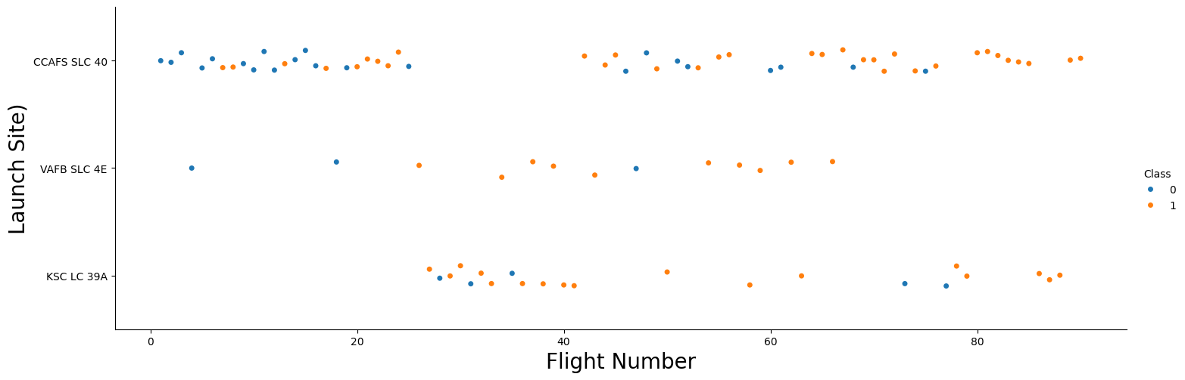
Flight Number vs. Launch Site
The scatter plot below shows the relation between the number of flight and the launch site, showing an increase in success rate when the launch in a place increases

Slide 18
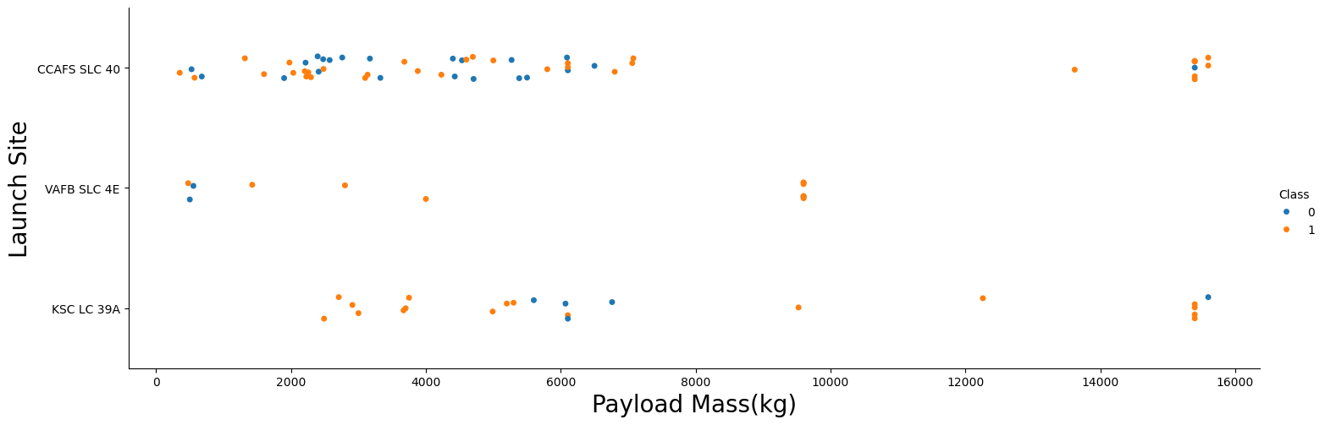
Payload vs. Launch Site
This scatter shows how the probability of a successful launch increases when the payload mass is greater tan 7000 kg

Slide 19
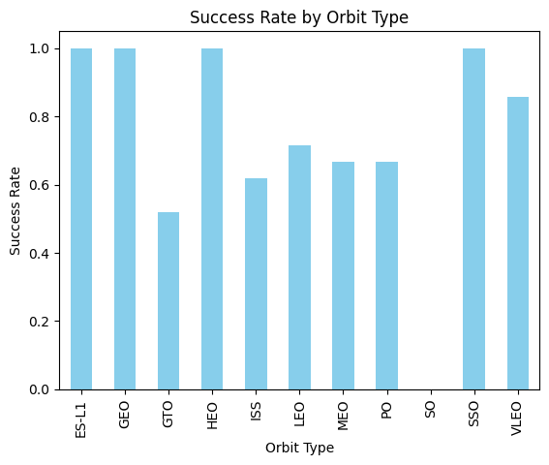
Success Rate vs. Orbit Type
The Bar chart shows some orbit where the success rate is 1, so no failures on ES-L1, GEO, HEO and SSO orbits.
SO orbit is set to be the worst to launch a rocket, because of the highest rate of failure

Slide 20
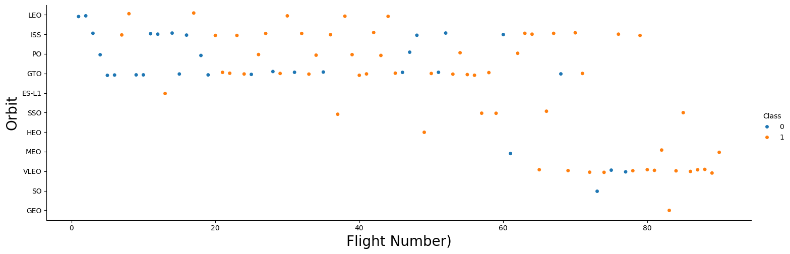
Flight Number vs. Orbit Type
As mentioned before, there is a high success rate for some orbits, but here we see that those values may be confusing, specially in GEO and HEO orbits, because only 1 launch took place here.

Slide 21
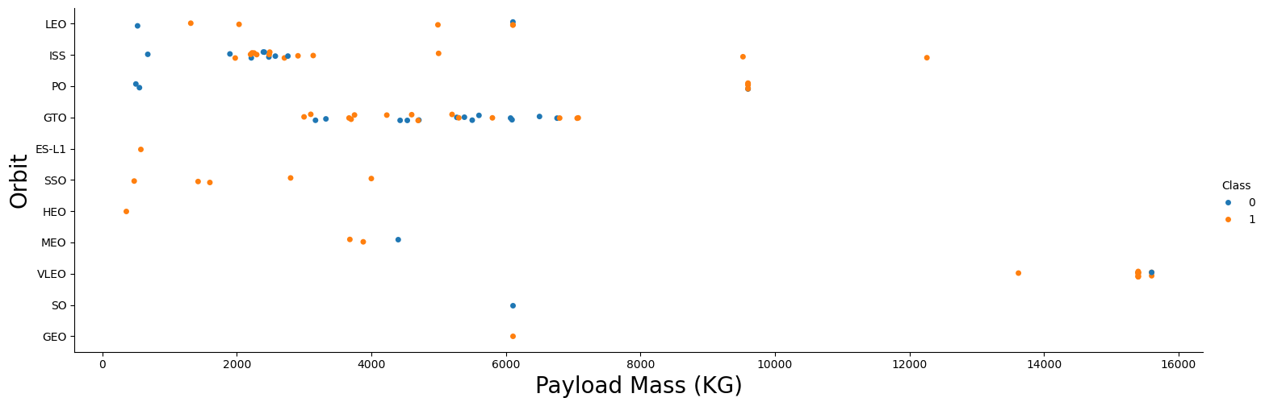
Payload vs. Orbit Type
Heavier payload has a positive impact, specially on ISS and PO orbits, while having a negative impact on MEO and VLEO orbits. Some of the orbits are seem to need more values to make certain conclusions

Slide 22
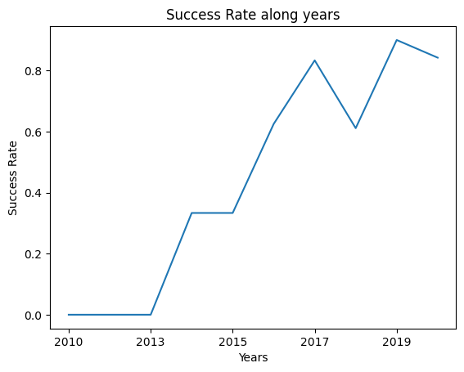
Launch Success Yearly Trend
This line chart shows a clear impact on space race from 2013, maintaining a constan increase of the success rate, except between 2017 and 2018, the rate has only increased.

Slide 23
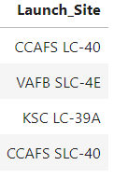
All Launch Site Names
We used the key word DISTINCT to show unique launch sites

Slide 24
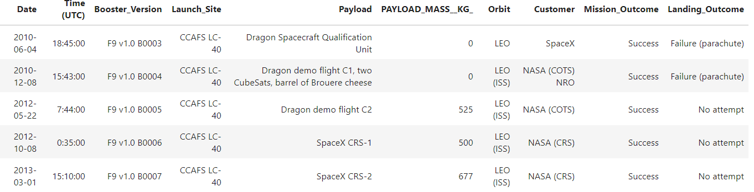
Launch Site Names Begin with 'CCA'
To obtain this query, we added the key LIKE in clause WHERE to search for an incomplete name. Because we knew the begin was ‘CCA’ the % symbol was needed (CCA%) to search for the correct Launch sites. After the query was limited with LIMIT clause

Slide 25
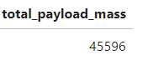
Total Payload Mass
To calculate the total payload Mass in kg we used function SUM for this variable, then we specified in clause WHERE the customer options (NASA CRS, in this case):

Slide 26
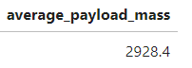
Average Payload Mass by F9 v1.1
Same operation than we did on the last query, but changing the function to use (AVG to perform average) and we selected where Booster_Version was equal to Falcon 9 V1.1 model:

Slide 27
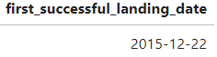
First Successful Ground Landing Date
This query was performed with AND attribute on clause WHERE. First, we filtered the mission outcomes that where successful, after that the landing outcome feature had to include the words ‘ground Pad’ (encapsuled in % symbol and using LIKE clause):

Slide 28
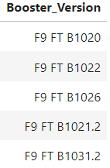
Successful Drone Ship Landing with Payload between 4000 and 6000
Again, we used the clauses AND, LIKE to determine which boosters have succeeded in drone ship. Inequity symbols (<,>) were used to determine the range for the payload mass:

Slide 29
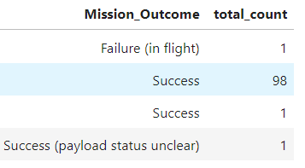
Total Number of Successful and Failure Mission Outcomes
Here we only needed to use the function COUNT on the mission outcome feature. All the outcomes were grouped with GROUP BY clause for the same feature:

Slide 30
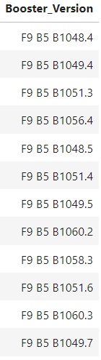
Boosters Carried Maximum Payload
Here we used a subquery to list the names of the booster versions that carried the maximum payload. To obtain this query, we used the function MAX on the subquery. This are the results:

Slide 31
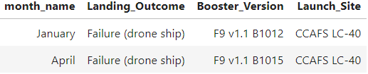
2015 Launch Records
As specified, SQL Lite does not support month names, we did a substring to convert every month to its corresponding number. After that, we selected the date equal to 2015:

Slide 32
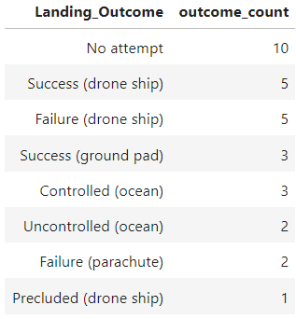
Rank Landing Outcomes Between 2010-06-04 and 2017-03-20
Last, we ranked the landing outcomes between 2 specified dates, using the clause BETWEEN – AND. The data was grouped and ordered in descending order:

Slide 33

Section 3

Slide 34
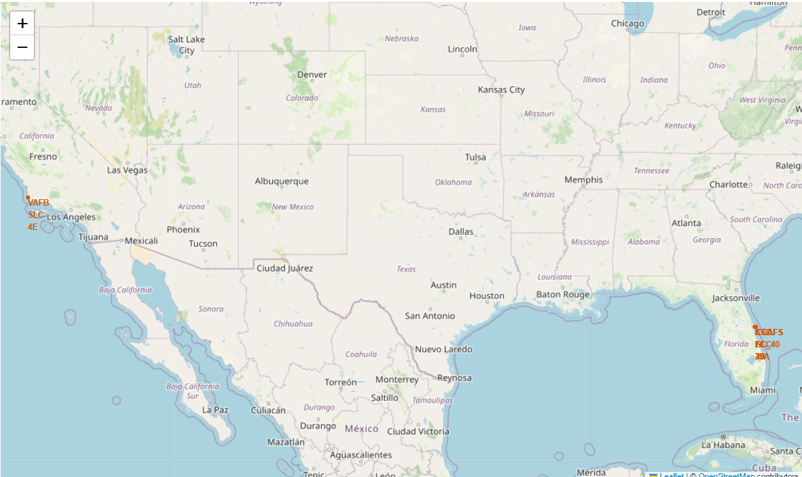
Mapping the Launch Sites
In this folium map, the different launch sites can be seen, despite in Cape Canaveral multiples locations are used to launch rockets, so the name of the places are overlapping.
Graphic elements such as markers and circles are used to point on the map

Slide 35
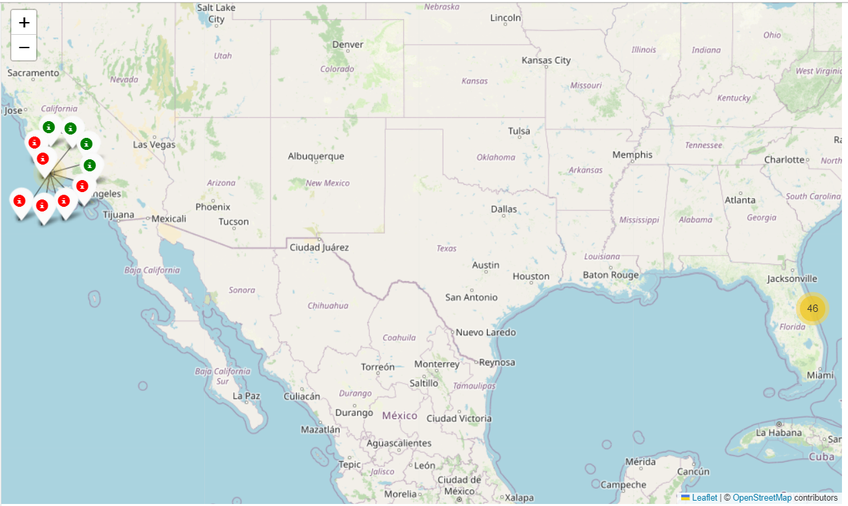
Types of launches
The following map shows whether the launch has succeeded (green) or not (red). As mentioned early, in the coast of Florida several locations for launches are used.
The original map does not show immediately the state of the launch, so all locations are shown on a yellow circle (as it appears on the right part of the map) but when clicking to a specific location the status is shown (as in left)

Slide 36
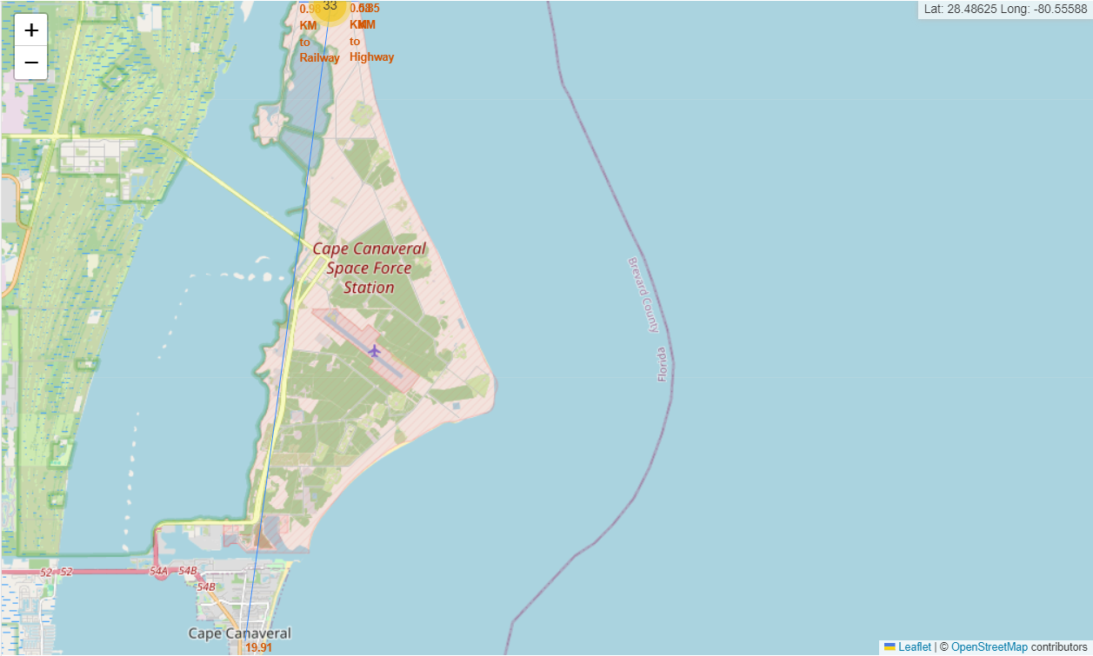
Nearest places to launching site
Places marked with the respective distances from the rocket launching site. Since the nearest city is Cape Canaveral, the display could not show precisely all features marked, but still there are a line and the distance to:
Coast
City
Railway
Highway

Slide 37

Section 4

Slide 38
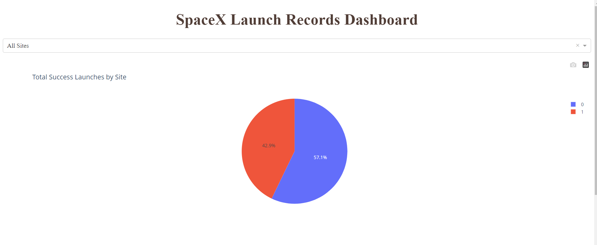
Interactive Dashboard with Plotly
SpaceX Launch Records Dashboard for all sites. This pie chart shows how 57,1% of the launch have not succeed

Slide 39
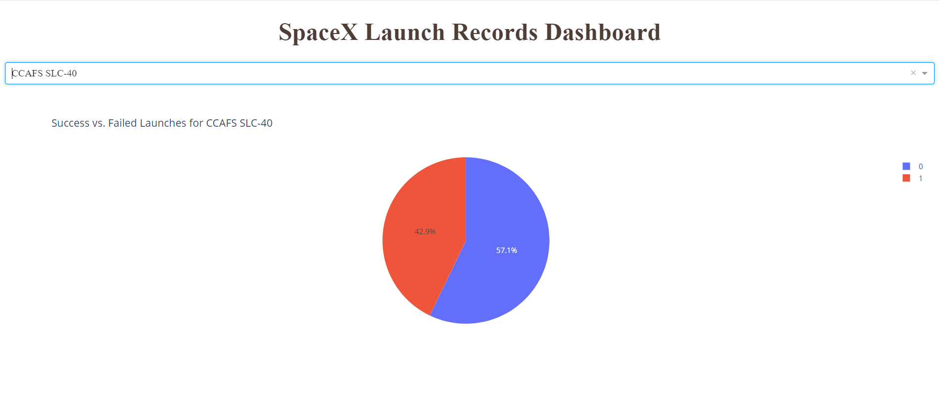
Highest success radio site
From this pie we can see how CCADS SLC-40 is the place with the highest success rate for launching.

Slide 40
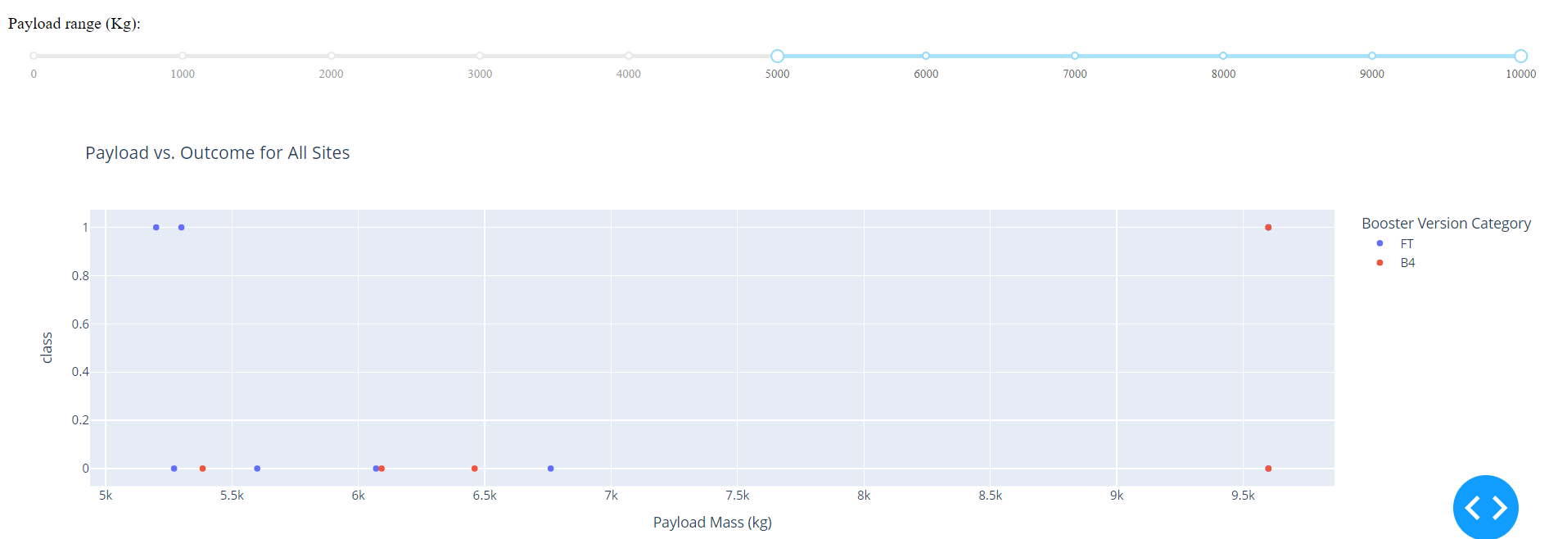
<Dashboard Screenshot 3>
Here we can see a comparison of Payload and Outcome for all sites, with the range above 5000 kg. Most launches failed with this characteristics.

Slide 41

Section 5

Slide 42
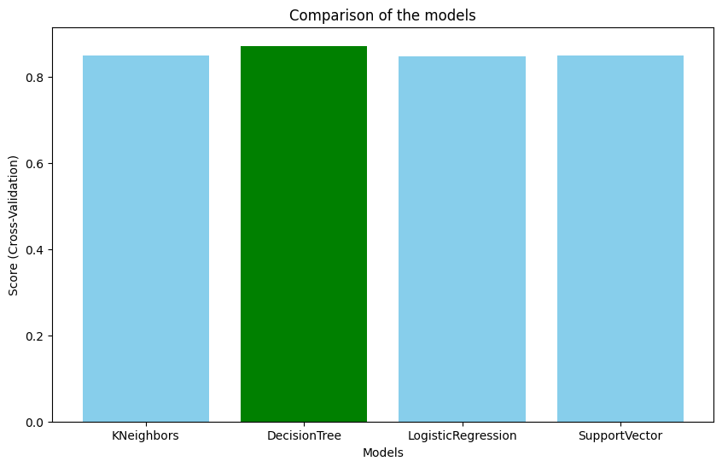
Classification Accuracy
As we can see, all models perform similar on our database, but still we can find that Decision Tree Classifier outperforms the other machine learning models.

Slide 43

Confusion Matrix
The confusion matrix of Decision Tree model shows that 15 stages were right classified, according to the real data (True labels). The presence of 3 false negative values means that with the specified features, the Tree model expected 3 cases to land successfully, while they were not.

Slide 44
Conclusions
After conducting a thorough analysis and applying Data Science techniques to the SpaceX Falcon 9 launch records, we reached the following key insights:
Higher Flight Frequency Correlates with Success: Launch sites with a greater number of flights tend to have higher success rates.
Significant Improvement Over Time: A notable increase in launch success rates has been observed since 2013.
Orbit Performance Varies: Orbits such as ES-L1, GEO, HEO, SSO, and VLEO demonstrated high success rates; however, caution is needed for those with fewer recorded launches.
KSC LC-39A Leads in Successful Launches: This site recorded the highest number of successful launches among all locations.
Best Predictive Model: Among the machine learning models tested, the Decision Tree Classifier provided the most accurate predictions for launch success.

Slide 45


